Slide 1
Small Language Model
Vs
Large Language Model

Slide 2
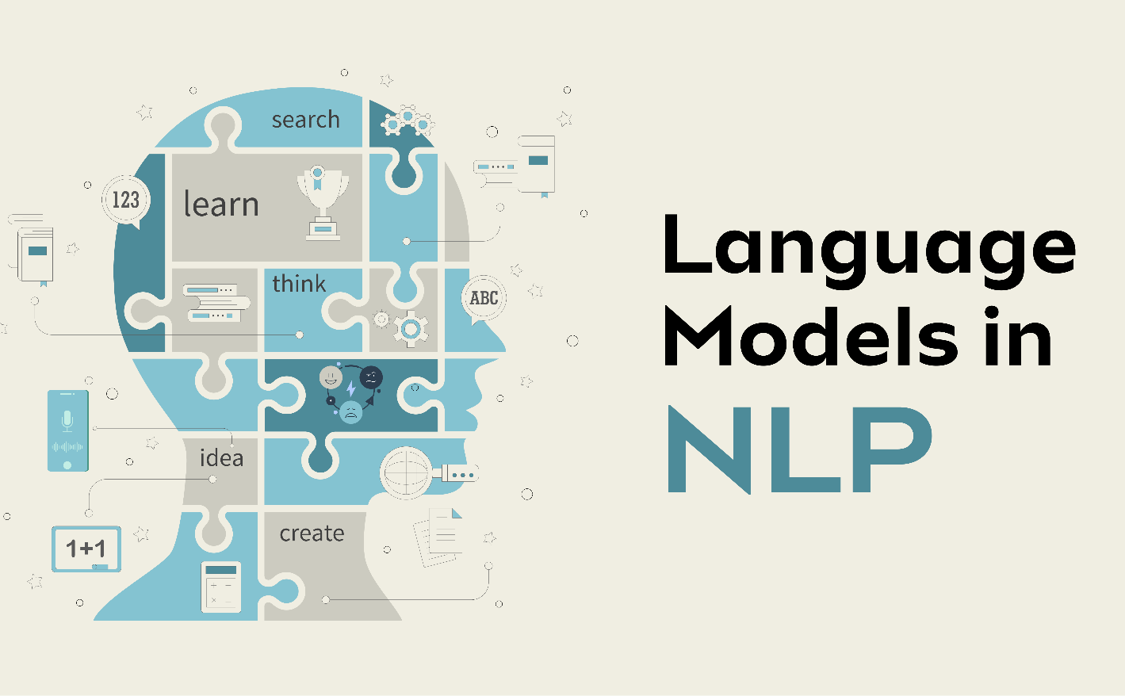
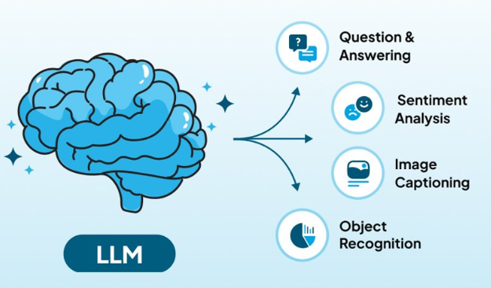


LANGUAGE MODEL

Slide 3
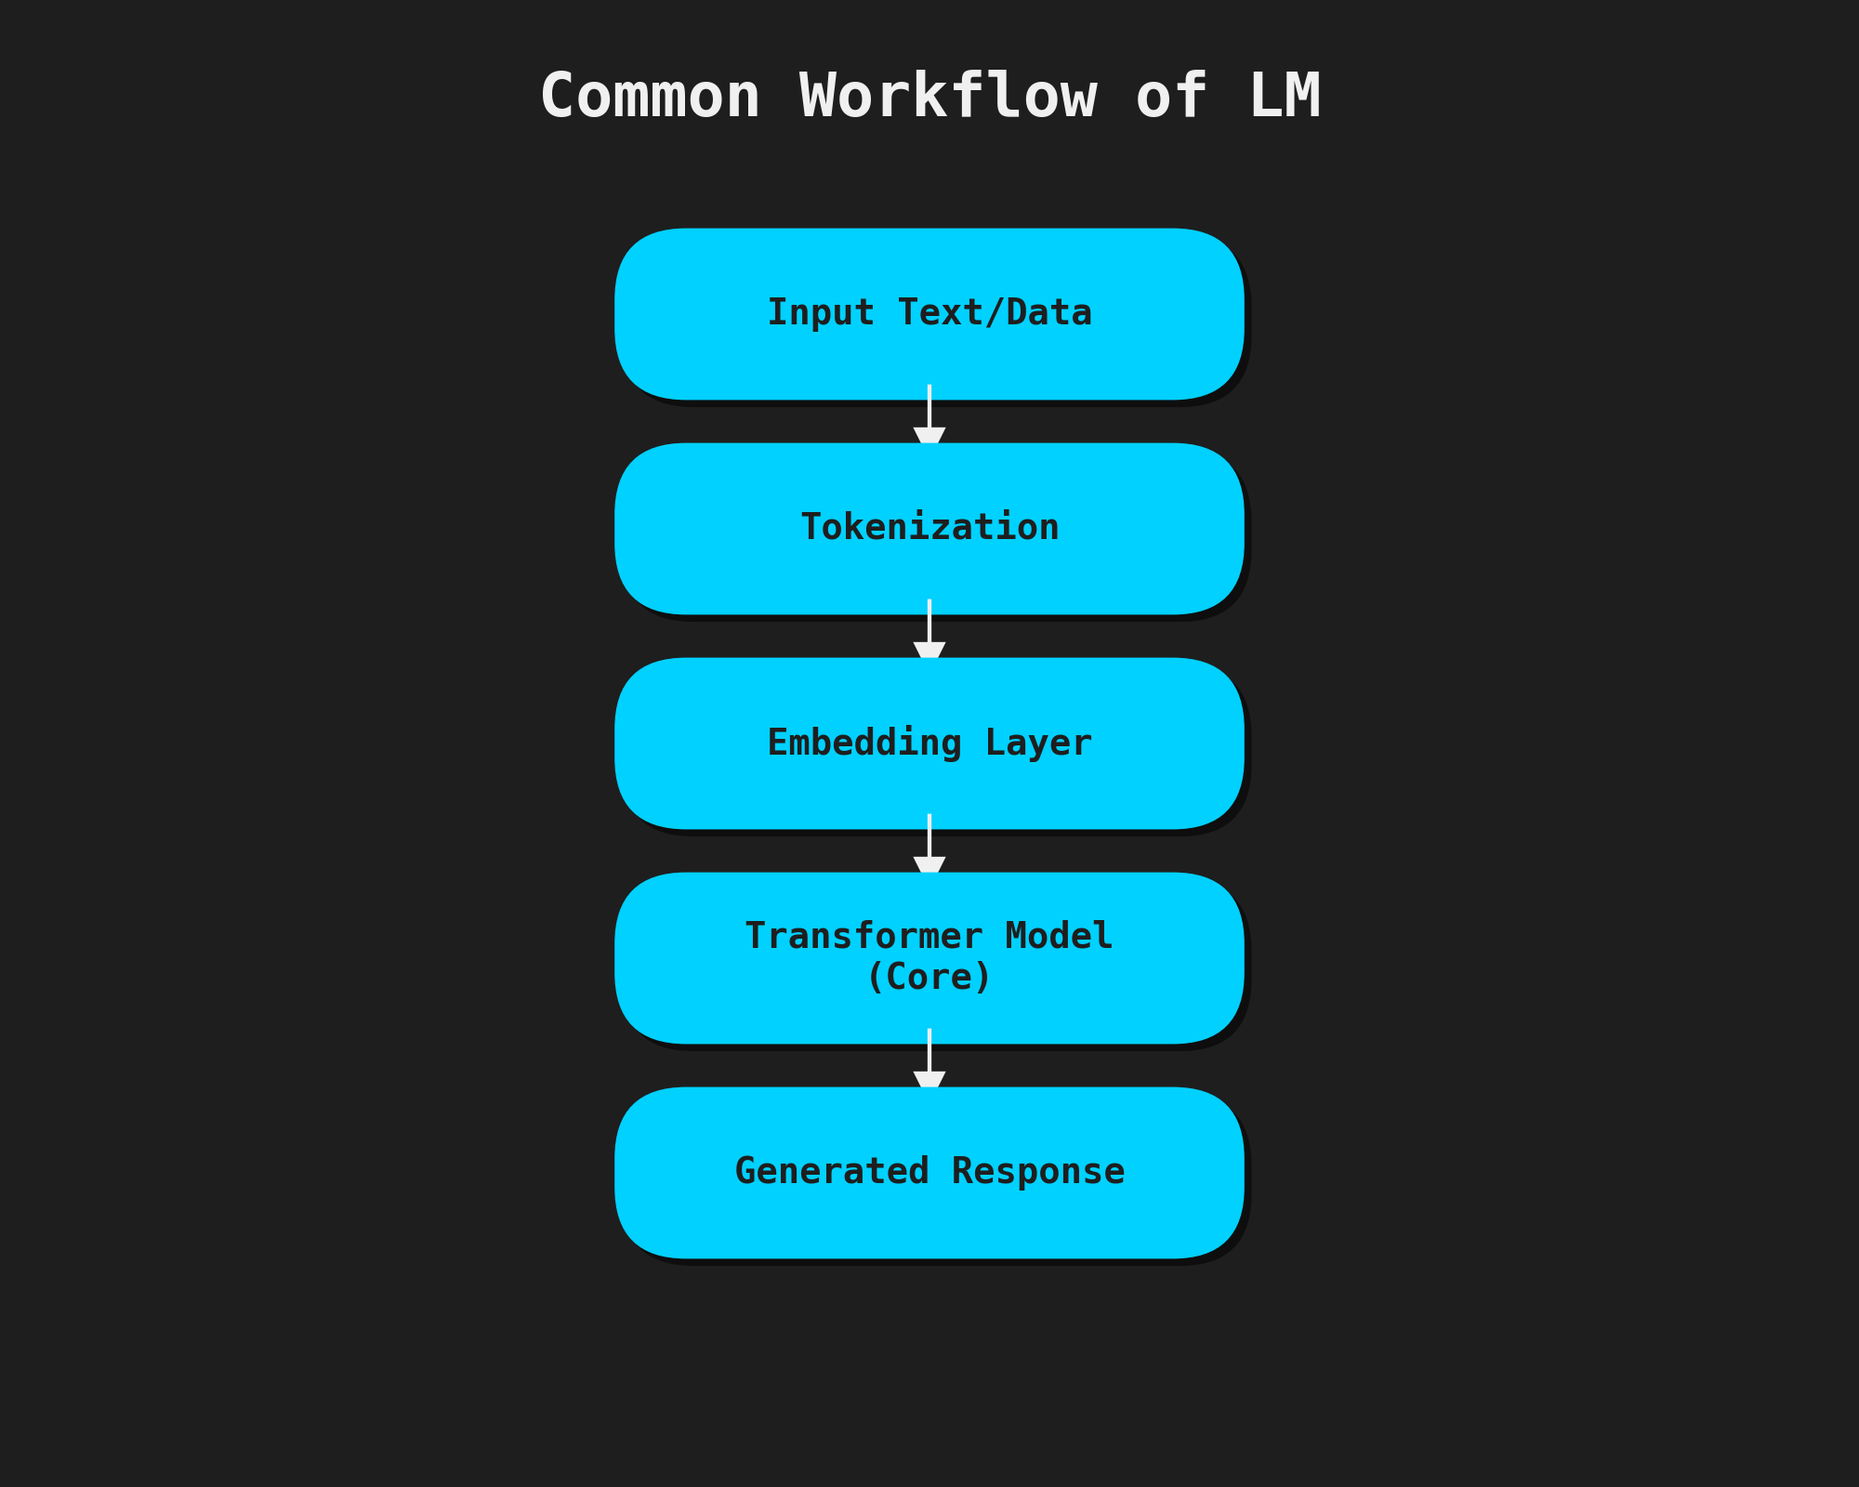

Slide 4
SLM VS LLM
Highly efficient, lightweight models designed for specific tasks and optimized for local deployment. They require fewer parameters and can run on edge devices making them ideal for real-time applications.
Examples
Phi-3, Phi-2
Llama 3 (8B)
TinyLlama
Massive AI models trained on billions or trillions of parameters to achieve advanced reasoning, creativity, and multi-domain understanding.
Examples
GPT-4 / GPT-4o
Claude 3.5
Google Gemini
PaLM

Slide 5
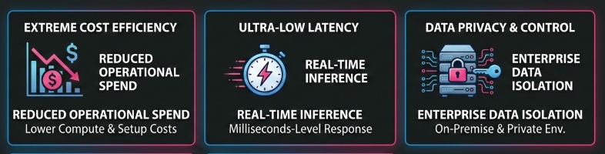
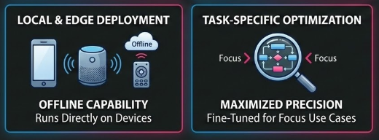
Advantages of SLMs

Slide 6
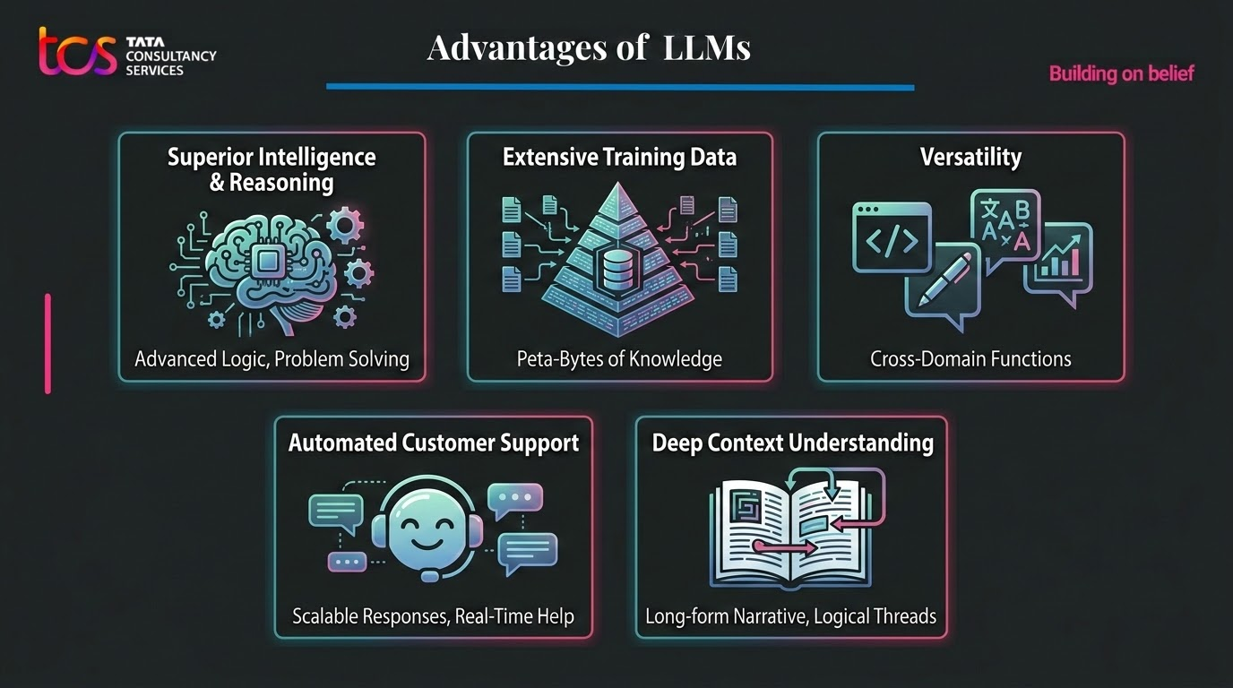

Slide 7

Challenges of SLMs
Limited Generalization
Lower Reasoning Capability
Requires Fine-Tuning Effort
Infrastructure Responsibility
Scaling Limitations

Slide 8
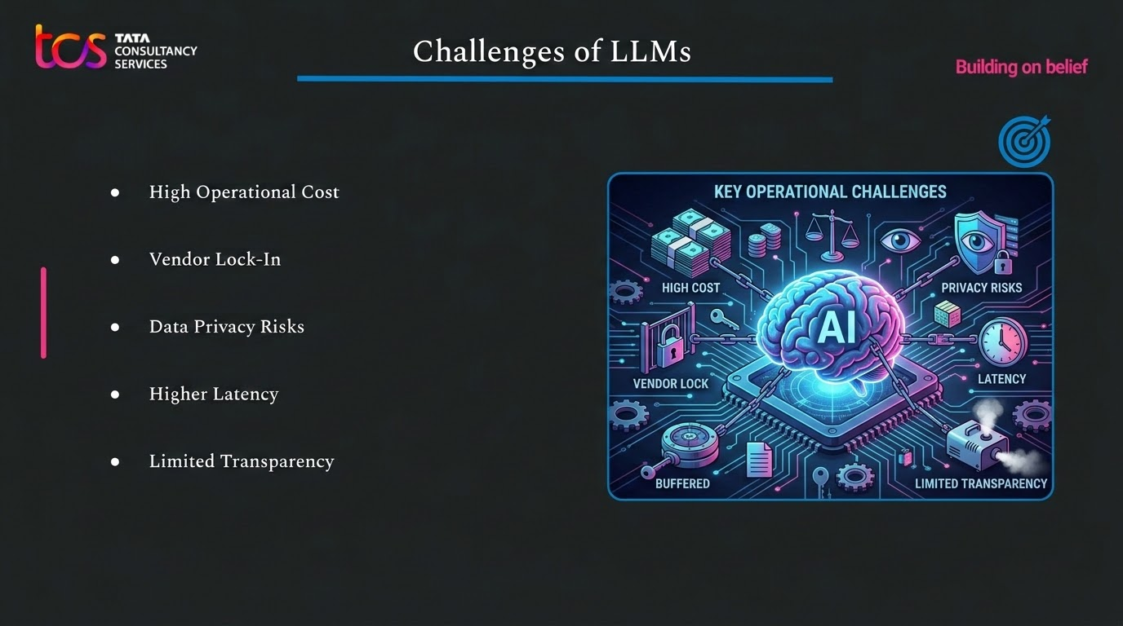

Slide 9
Performance Comparison
Metric | SLM (e.g., Llama‑3 8B / Phi‑3‑Mini) | LLM (e.g., GPT‑4o / Claude 3.5)
1. Accuracy (Targeted Task) | ~98.2% (high due to domain-specific fine-tuning) | ~98.6% (slightly higher but marginal difference)
2. Time-to-First -Token (TTFT) | ~100 ms (very fast, local execution) | ~450 ms (affected by network latency)
3. Throughput (Tokens/sec) | 400–800+ tokens/sec (high-speed generation locally) | 80–100 tokens/sec (limited by cloud processing)
4. Operational Cost | Very low (~$5/day, local compute cost) | Very high (~$450/day, API usage cost)

Slide 10
Performance Comparison
Metric | SLM (e.g., Llama‑3 8B / Phi‑3‑Mini) | LLM (e.g., GPT‑4o / Claude 3.5)
5. Hardware Footprint | 5–16 GB RAM (runs on laptops/edge devices) | Requires 150+ GB VRAM (data center-level GPUs)
6. Data Privacy & Compliance | Fully local → no external data exposure | Data sent to cloud → potential privacy concerns
7. Context Window Capacity | Limited (8K–32K tokens) | Very large (200K–1M+ tokens)
8. Multi-Step Reasoning | Moderate capability (struggles with complex logic) | Strong reasoning (handles advanced tasks and creativity)

Slide 11
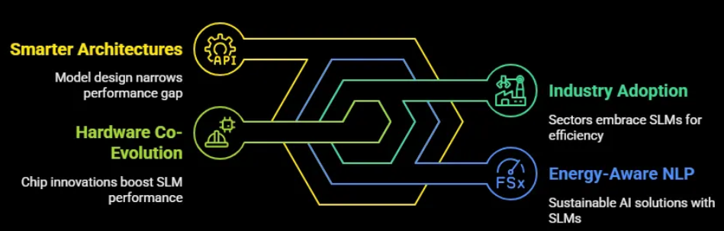
Future Trends: SLM
Rise of Edge & On-Device AI
Enterprise Cost Optimization
Domain-Specific AI Growth
Privacy-First AI Adoption

Slide 12
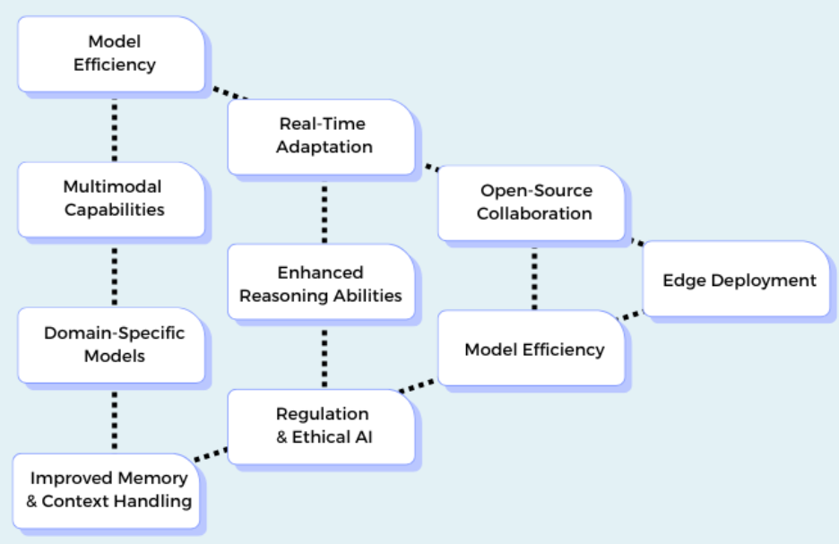
Future Trends: LLM
Advancement in Reasoning & Multimodality
Unified AI Platforms
Expansion of Context Windows
AI-as-a-Service Growth

Slide 13
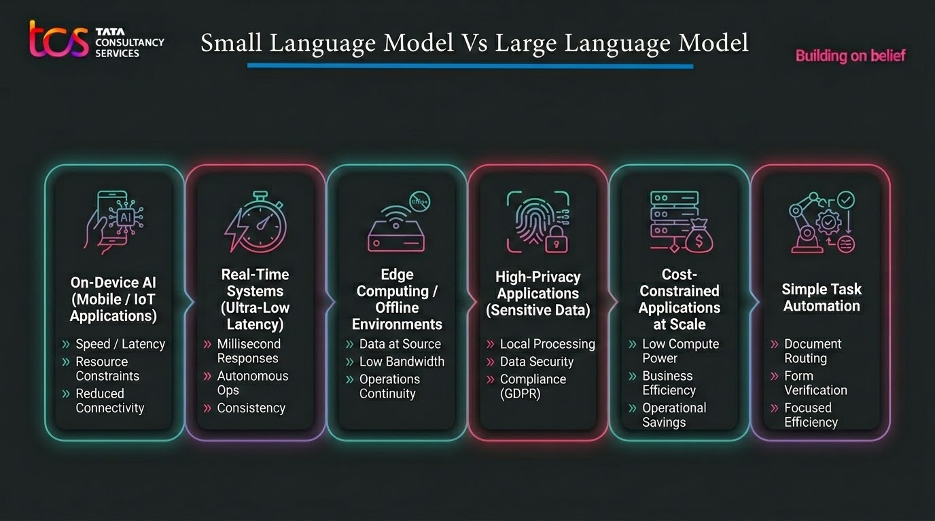


Slide 14
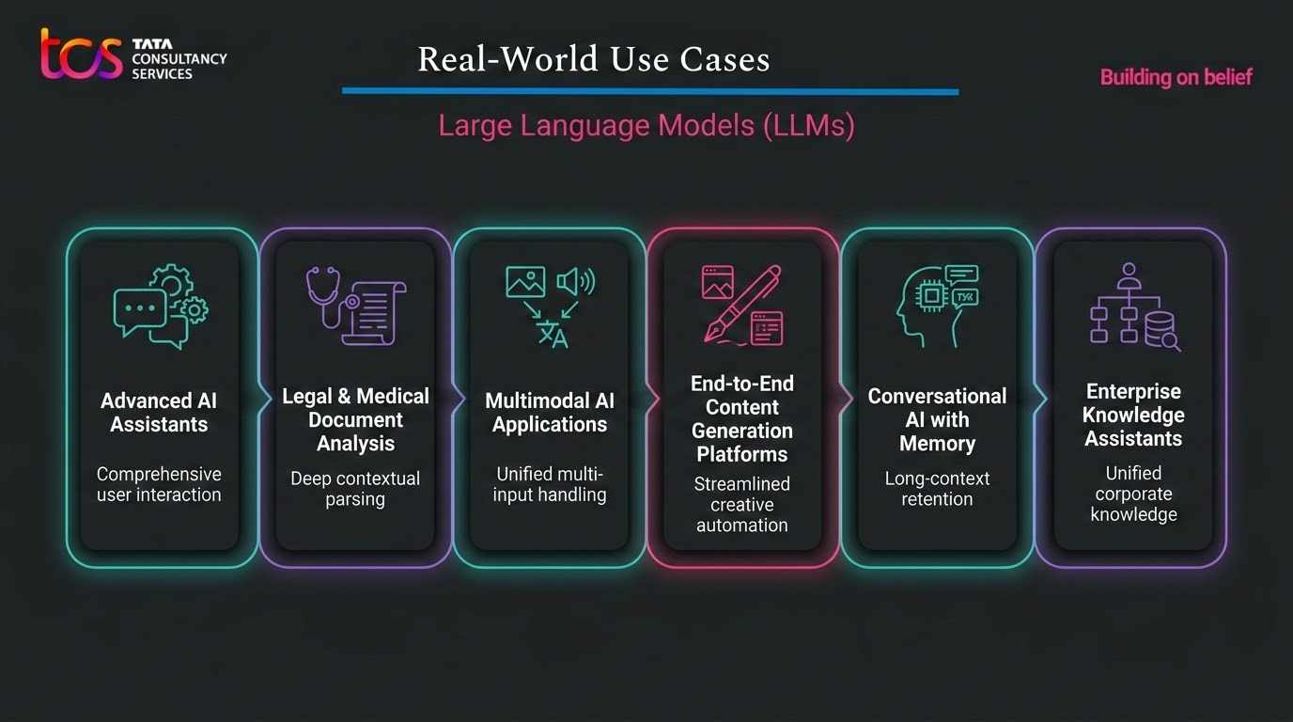

LLM

Slide 15
Thank You

